Slide 1




Some tips for CS Success
Prof. Ann Marie Schilling

Slide 2
Start Early
When you receive an assignment in class, read through it that night and formulate how you will solve the problem.
Determine which parts will be easy to solve and which parts you do not know how to solve.

Slide 3
Ask sooner than later
Start working on the easy parts the day you receive the project
Schedule a time to meet with the TA or the professor to get assistance with the difficult parts

Slide 4

Break it down
When you first get a project assignment, you may feel overwhelmed.
Break the problem into sub problems, and complete the project piece by piece.

Slide 5
Understand the Timeline
I distribute assignments a certain amount of time before the due date because I expect you to need approximately that much time to complete the project.
To complete the project in time with the least amount of stress, set goals for yourself during that time span.

Slide 6
Sample Timeline – 1 week
Day 1 Receive Project
Read Description
Formulate Solution
Create your skeleton files to get started
Ask for help if needed
Day2 Do the Easy Parts
Pseudocode comments
Find Variables
Determine Input/Output
Ask for help if needed
Days 3-5 Flesh it out
Write the code
Debug
Get Help if Needed
Test different input values (if applicable)
Days 6-7 Finish and Submit
Tidy up documentation
Check all parts are submitted

Slide 7

A Handy Mantra

Slide 8
Be thorough
Many times, there is more to the assignment than getting the program to run:
Documentation
Explanatory Write Up
Users Manual
Before you submit your work, be sure to check that you have included all parts of the assignment.

Slide 9
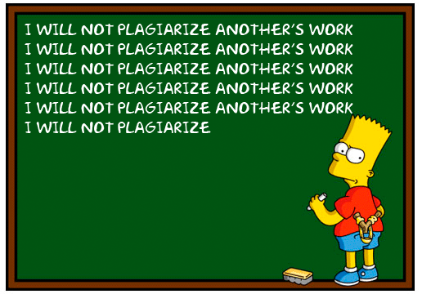
Finally…

